Slide 1




SECURE CLIENT-SERVER CALCULATOR APPLICATION: SDLC SECURITY INTEGRATION
TERRELLE THOMAS

Slide 2



AGENDA
Introduction
Overview of the Project
Secure Development Lifecycle (SDLC) Phases
Security Integration at Each SDLC Phase
Testing and Results
Risk Assessment & Mitigation
Business Continuity and Disaster Recovery
Conclusion and Key Findings
02

Slide 3
INTRODUCTION
In this project, we aim to build a small client-server calculator application in a virtual environment where VMs are connected via a bridge connection to allow seamless communication. Throughout this process, we systematically embed security practices at every phase of the Software Development Life Cycle (SDLC). This approach highlights the significance of incorporating security measures early on and maintaining them continuously throughout the development lifecycle. Our objective is to create a secure, functional calculator application while demonstrating the critical role of proactive security integration.
03

Slide 4



Thynk Unlimited
Virtualization Platforms:
VMware (Kali Linux): Used for creating virtual environments to host the server and client machines.
VirtualBox (Kali Linux): Another virtual environment option, enabling communication across VMs.
COMPONENTS
Operating Systems:
Kali Linux: A Linux distribution designed for penetration testing and security-focused tasks.
Ubuntu: An additional Linux distribution for testing client-server communication.
Programming Language:
Python: Used to build both the server and client-side applications.
Flask: A lightweight Python web framework for creating the server.
Requests: Python library used for making HTTP requests from the client to the server.
04

Slide 5
Thynk Unlimited
Network Configuration:
Bridge Connection: Configured to enable seamless communication between VMs, simulating real-world networking environments.
COMPONENTS
05

Slide 6


Thynk Unlimited
INSTRUCTIONS
Environment Setup:
Set up two VMs (VM1 & VM2) with Python 3.x.
Enable Bridge Connection between VMs for communication.
2. Server Setup (VM1):
Install Flask (pip3 install flask).
Develop a Python-based Flask server to handle basic calculation requests (add, subtract, multiply, divide).
Run the server on Port 5000 to accept requests.
3. Client Setup (VM2):
Install Requests library (pip3 install requests).
Create a client that sends calculations to the server using POST requests.
Test Communication:
Start the server on VM1 and use VM2 to send calculation requests.
Verify responses for accuracy and proper communication between VMs.
06

Slide 7
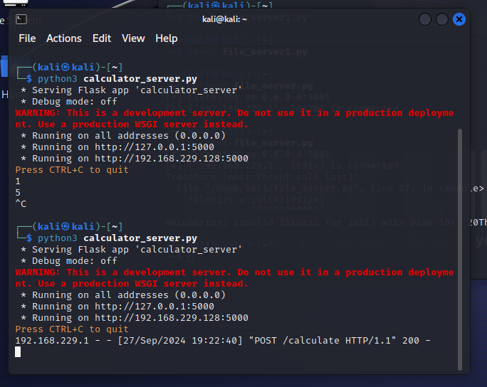
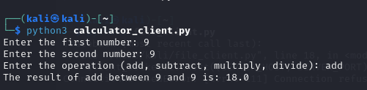
Thynk Unlimited

Slide 8
Thynk Unlimited
SDLC CYCLE OVERIEW
Planning
Design
Implementation
Testing
Deployment
Maintenance

Slide 9
Planning/Requirements Gathering
In the Planning and Requirements Gathering phase, a comprehensive security risk assessment will identify potential risks and vulnerabilities using threat modeling techniques like STRIDE. This proactive approach enables effective mitigation throughout the Software Development Life Cycle (SDLC). Specific security requirements will be defined in alignment with industry standards such as the OWASP Top 10, establishing a solid foundation for secure development practices. Compliance needs will be identified using the Secure Software Development Framework, ensuring regulatory standards are met from the start. A dedicated budget of $8,500 - $17,000 will be allocated for security-related activities, tools, and training, as adequate resources are essential for effective security measures.
Rationale: By prioritizing security early on, the project can address vulnerabilities proactively, significantly reducing the risk of costly fixes later in the development process.
PLANNING/REQUIREMENTS GATHERING
07

Slide 10
DESIGN
During the Design phase, secure design principles will be implemented, emphasizing the application of concepts such as least privilege and defense in depth. These principles form the backbone of a secure software architecture. A detailed architecture risk analysis will be conducted using methodologies like PASTA to identify potential security weaknesses within the system architecture. Robust mechanisms for user authentication and authorization will be designed, including multi-factor authentication, to ensure strong access controls that protect sensitive data. Furthermore, a comprehensive data protection strategy will be established, focusing on secure data storage, transmission, and handling of sensitive information. This will involve the use of AES-256 encryption for data at rest and TLS (Transport Layer Security) for data in transit, ensuring sensitive data is protected from unauthorized access or tampering throughout its lifecycle.
DESGIN
Rationale: Protects sensitive data from unauthorized access or tampering.
08

Slide 11
Implementation/Coding
In the Implementation and Coding phase, secure coding practices will be adhered to by following established guidelines, such as the OWASP Secure Coding Practices. This approach significantly reduces the introduction of common security vulnerabilities during coding. Input validation and output encoding will be implemented to prevent injection attacks, utilizing techniques like parameterized queries to safeguard against SQL injection. Cryptography will be employed using approved and up-to-date cryptographic libraries, avoiding the implementation of custom cryptographic algorithms to ensure proven, secure methods are utilized. Regular peer code reviews will also be conducted, focusing specifically on security aspects, helping to identify issues that automated tools may miss.
IMPLEMENTATION/CODING
Rationale: By focusing on secure coding practices, the project minimizes the risk of vulnerabilities during development, ensuring that the application remains secure and functions as intended.
09

Slide 12
Testing
The Testing phase will involve the development of security-focused unit tests that specifically target security functionalities within the application, ensuring that components behave securely as expected. Thorough penetration testing will be conducted, simulating real-world attack scenarios to uncover exploitable vulnerabilities, involving both internal teams and external security experts. Regular vulnerability scanning will be performed on the application and its dependencies using Static Application Security Testing (SAST) and Dynamic Application Security Testing (DAST) tools to identify known vulnerabilities. Fuzz testing will also be implemented, providing invalid, unexpected, or random data as input to uncover potential security flaws that could lead to issues.
TESTING
Rationale: Comprehensive testing ensures that the application can withstand potential attacks and functions securely under various conditions, ultimately enhancing the overall security posture of the application.
10

Slide 13
Deployment
During the Deployment phase, secure configuration management will be established, implementing and maintaining secure configurations for all components using configuration management tools. Automated deployment tools will be utilized with built-in security checks and validations, ensuring consistent application of security measures throughout the deployment process. Furthermore, infrastructure-as-code practices will be employed to ensure repeatable and reliable deployments with security built into the process. Proper network segmentation will be implemented to limit the potential impact of security breaches, utilizing firewalls and access control lists to contain any incidents that may arise.
DEPLOYMENT
Rationale: Prevents security issues arising from misconfigurations, ensures consistent application of security measures during deployment, and contains potential security breaches, limiting lateral movement within the system.
11

Slide 14
Maintenance
In the Maintenance phase, a robust patch management process will be implemented to ensure timely application of security patches and updates for all software components, including third-party libraries. Continuous monitoring and logging systems will be set up to detect security events, employing Security Information and Event Management (SIEM) solutions for real-time analysis. An incident response plan will be developed and regularly updated, conducting periodic drills to ensure preparedness for potential security breaches. Lastly, regular security assessments will be conducted to identify new vulnerabilities through automated scans and manual reviews, addressing evolving threats to maintain an ongoing strong security posture.
MAINTENANCE
Rationale: Ongoing maintenance and vigilance are crucial to adapting to new threats and ensuring the application remains secure over time, protecting both user data and the integrity of the application.
12

Slide 15
Thynk Unlimited
Planning/Requirements Gathering
Threat Modeling Tools: Microsoft Threat Modeling Tool, OWASP Threat Dragon
Requirements Management Tools: JIRA, Confluence
TOOLS
Design
Modeling Tools: Lucidchart, Microsoft Visio
Architecture Analysis Tools: PASTA (Process for Attack Simulation and Threat Analysis)
Implementation/Coding
Integrated Development Environment (IDE): PyCharm, Visual Studio Code
Static Code Analysis Tools: SonarQube, Checkmarx
Version Control: Git, GitHub, GitLab
13

Slide 16
Thynk Unlimited
Testing
Automated Testing Tools: Selenium, JUnit
Penetration Testing Tools: OWASP ZAP, Burp Suite
Vulnerability Scanning Tools: Nessus, OpenVAS
TOOLS
Deployment
Configuration Management Tools: Ansible, Puppet, Chef
Containerization Tools: Docker, Kubernetes
Maintenance
Monitoring Tools: ELK Stack (Elasticsearch, Logstash, Kibana), Prometheus
Incident Response Tools: Splunk, PagerDuty
Patch Management Tools: WSUS (Windows Server Update Services), Ivanti
14

Slide 17
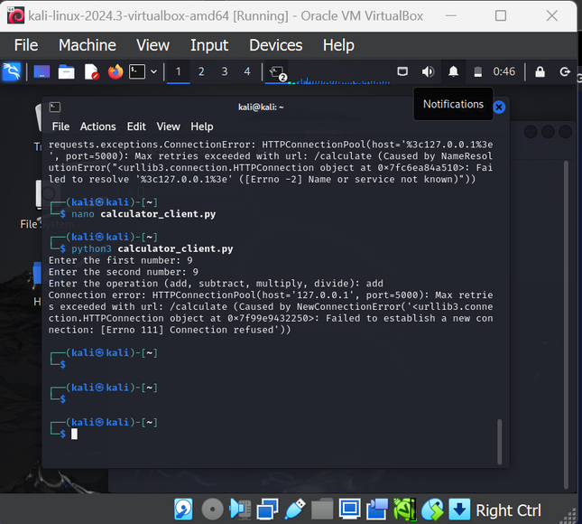
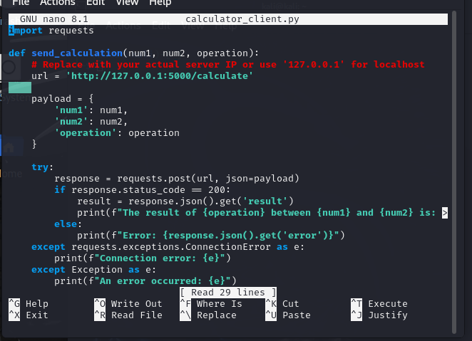
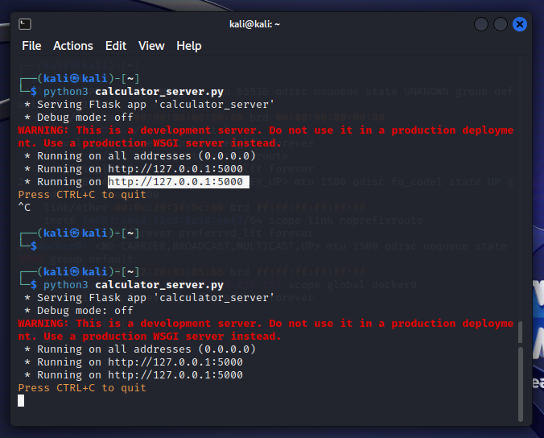
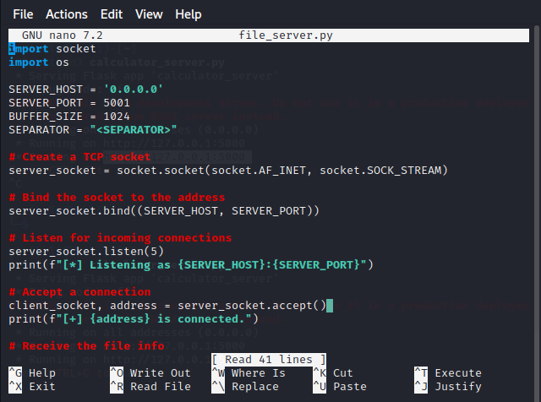
15

Slide 18
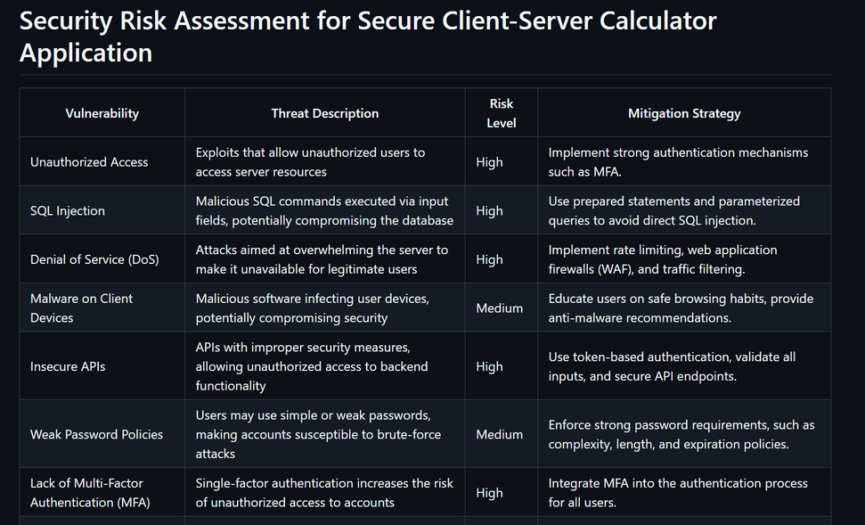
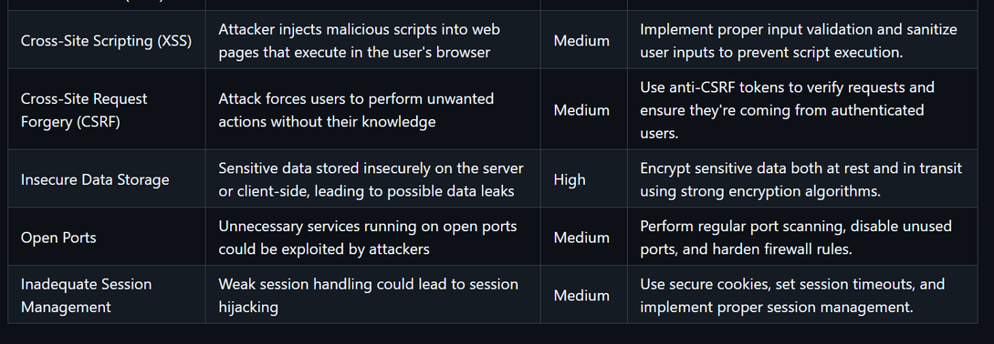
RISK ASSESSMENT
16

Slide 19
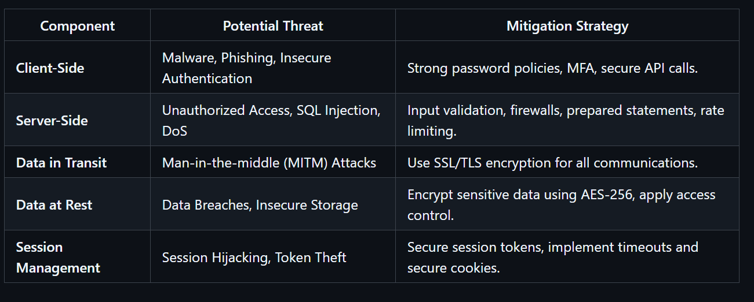
THREAT MODELING
17

Slide 20
Thynk Unlimited
CODING PRACTICES
Secure coding practices are vital to mitigate prevalent vulnerabilities, including injection attacks, broken authentication, and data exposure. Input validation is essential for all user inputs to protect against SQL injection and cross-site scripting (XSS) attacks. Utilizing prepared statements is essential when engaging with databases to mitigate the risk of SQL injection. Effective session management, encompassing secure cookie flags (HttpOnly, Secure) and session expiration, is essential for minimizing the risk of session hijacking. Sensitive data must consistently be encrypted, both during transmission using TLS and while stored using robust encryption standards like AES-256. Error handling must be implemented to ensure that system internals are not exposed to potential attackers. Additionally, the principle of least privilege should be enforced to ensure that users and services receive only the permissions essential for their specific functions.
18

Slide 21
Thynk Unlimited
VULNERABILITY SCANNING RESULTS
Regular vulnerability scanning is crucial for detecting and addressing weaknesses in the secure client-server calculator application. Tools such as OWASP ZAP, Nessus, and Burp Suite can be utilized to identify common vulnerabilities that could jeopardize the system. For example, SQL injection is a significant risk, and mitigation strategies encompass the use of prepared statements and the validation of user inputs. Insecure session handling, including the lack of secure cookies and insufficient session timeouts, can result in session hijacking, highlighting the importance of implementing secure session management practices. Additionally, weak password policies present medium risks, which can be mitigated by enforcing strong passwords and implementing multi-factor authentication (MFA). Vulnerability scans should be conducted continuously throughout the software development life cycle (SDLC) to promptly identify and address newly emerging vulnerabilities, thereby enhancing the application's security.
19

Slide 22
Thynk Unlimited
SECURITY TESTING
Security testing must be incorporated into the software development life cycle (SDLC) of the secure client-server calculator application to maintain continuous protection against vulnerabilities. Penetration testing simulates real-world attacks to identify exploitable vulnerabilities in the application, enabling developers to resolve these issues prior to their exploitation by malicious entities. Static Application Security Testing (SAST) is critical for the early identification of potential security vulnerabilities in the source code, guaranteeing that issues are resolved during the development process. Dynamic Application Security Testing (DAST), conversely, concentrates on detecting security issues during the application's operation, offering insights into vulnerabilities within a production-like environment. Additionally, fuzz testing can be employed to input random or malformed data into the system, assisting in the identification of unexpected behaviors or crashes, and thereby enhancing the application's resilience against unpredictable attacks.
20

Slide 23
Thynk Unlimited
BUSINESS CONTINUITY AND DISASTER RECOVERY PLANS
A comprehensive business continuity and disaster recovery (BCDR) plan for the secure client-server calculator application guarantees its resilience against failures or disasters. The recovery time objective (RTO) aims to restore the calculator's functionality within 4 hours to minimize disruption, while the recovery point objective (RPO) is set to 1 hour, permitting minimal data loss, including calculation logs or user inputs. A comprehensive backup strategy that includes daily backups of essential data and configurations to secure locations is crucial for protecting against data loss. The incident response plan must outline precise procedures for detecting, containing, and addressing security breaches or system failures, while keeping users informed about any effects. Implementing failover mechanisms, such as redundant servers or cloud-based solutions, will ensure that the application remains operational during outages by automatically switching to backup systems, thereby minimizing downtime and maintaining continuity for users.
21

Slide 24
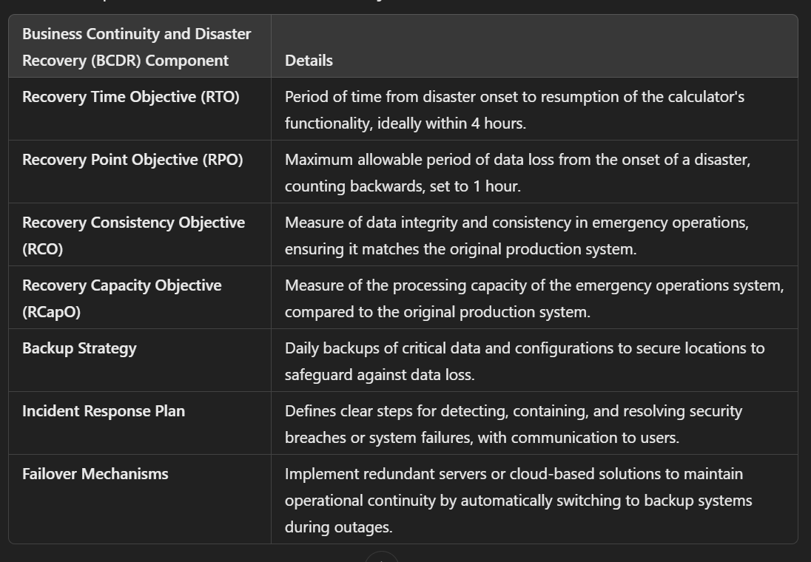
22

Slide 25
Thynk Unlimited
NETWORK SECURITY MEASURES (INCLUDING SNIFFER DETECTION)
Robust network security measures are essential to protect communications and prevent unauthorized access in the secure client-server calculator application. Firewalls act as the initial barrier, regulating traffic between the client and server according to established security protocols. Intrusion Detection Systems (IDS) monitor network traffic for anomalous activity, assisting in the identification of potential breaches or attacks on the application. Sniffer detection tools such as Wireshark and Snort can be utilized to detect packet sniffing attempts that attackers may employ to capture sensitive calculations or data while in transit. All communications between the client and server must be secured with SSL/TLS encryption to safeguard against man-in-the-middle (MITM) attacks, ensuring the confidentiality of the exchanged data. Additionally, network segmentation can improve security by isolating sensitive areas of the application and restricting access to critical resources. Lastly, utilizing virtual private networks (VPNs) for remote access guarantees that any external connections to the server are safeguarded against interception or unauthorized access, thereby maintaining the application's security.
23

Slide 26
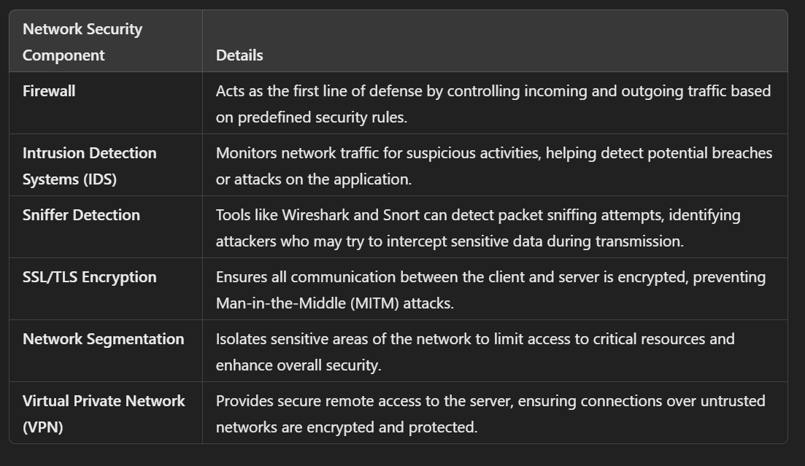
Thynk Unlimited
24

Slide 27
Thynk Unlimited
REFERENCES
1. Atlassian. (n.d.). IT disaster recovery: Strategies and best practices. https://www.atlassian.com/incident-management/itsm/disaster-recovery
2. Jones, E. (June 20, 2024). Disaster recovery testing: What it is, how it works and where to start. Warren Averett CPAs & Advisors. https://warrenaverett.com/insights/disaster-recovery-testing/
3. Kosutic, D. (n.d.). What is ISO 22301? Basics, how to comply, certification & more. 27001Academy. https://advisera.com/27001academy/what-is-iso-22301/
4. Swanson, M., Bowen, P., Phillips, A. W., Gallup, D., Lynes, D., US Department of Commerce, & National Institute of Standards and Technology. (2010). NIST Special Publication 800-34 Rev. 1 Contingency Planning Guide for Federal Information Systems. In NIST Special Publication 800-34 Rev. 1 Contingency Planning Guide for Federal Information Systems (p. 150) [Report]. National Institute of Standards and Technology. https://nvlpubs.nist.gov/nistpubs/Legacy/SP/nistspecialpublication800-34r1.pdf (Original work published 2010)

Slide 28

Thynk Unlimited
THANK YOU

